Slide 1
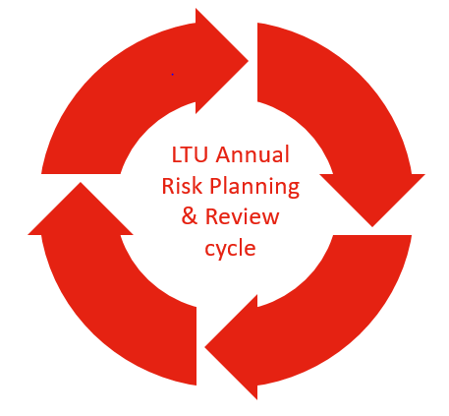
Risk Management Reporting Cycle
Q1 Jan-Mar
Key Risk Management Activities
Refresh of enterprise risk profile, including aggregation from updated business unit risk profiles (annual) Analysis of enterprise and business unit risks and emerging risks
Q1 CGARC Focus
Review and endorse the refreshed strategic risk profile SEG member presentation on high enterprise risk
Q2 Apr-Jun
Key Risk Management Activities
Refresh of risk appetite statement Communication of refreshed strategic risks and appetite to Business Units
Q2 CGARC Focus
Finalise and endorse updated risk appetite statement. Review risk profile for emerging or escalating risks SEG member presentation on high enterprise risk
Q4 Oct-Dec
Key Risk Management Activities
Annual refresh of enterprise risk profile, including aggregation from updated business unit risk profiles, with SEG part of planning cycle
Q4 CGARC Focus
Review risk profile for emerging or escalating risks SEG member presentation on high enterprise risk
Q3 Jul-Sep
Key Risk Management Activities
Refresh of enterprise risk profile (half-year) Refresh of Business Unit risk profiles with SEG as part of business planning cycle
Q3 CGARC Focus
Review and endorse the refreshed enterprise risk profile SEG member presentation on high enterprise risk
CGARC Quarterly Standing Risk Agenda Items
In addition to these quarterly CGARC focus areas and discussions, the following standing agenda items may be scheduled at each CGARC meeting: Review any enterprise risks that exceed predefined tolerance thresholds Review significant changes to any enterprise risks A rolling brief on selected enterprise risks, ensuring each risk is considered at least once quarterly

